Slide 1

Inferences Based on Two Samples
Copyright © Cengage Learning. All rights reserved.

Slide 2
Inferences Concerning a Difference Between Population Proportions
Copyright © Cengage Learning. All rights reserved.

Slide 3
Inferences Concerning a Difference Between Population Proportions
Having presented methods for comparing the means of two different populations, we now turn attention to the comparison of two population proportions. Regard an individual or object as a success S if he/she/it processes some characteristic of interest (someone who graduated from college, a refrigerator with an icemaker, etc.).
Let p₁ = the proportion of S’s in population # 1 p₂ = the proportion of S’s in population # 2

Slide 4
Inferences Concerning a Difference Between Population Proportions
Alternatively, p₁(p₂) can be regarded as the probability that a randomly selected individual or object from the first (second) population is a success. Suppose that a sample of size m is selected from the first population and independently a sample of size n is selected from the second one. Let X denote the number of S’s in the first sample and Y be the number of S’s in the second. Independence of the two samples implies that X and Y are independent.

Slide 5
Inferences Concerning a Difference Between Population Proportions
Provided that the two sample sizes are much smaller than the corresponding population sizes, X and Y can be regarded as having binomial distributions. The natural estimator for p₁ – p₂, the difference in population proportions, is the corresponding difference in sample proportions

Slide 6
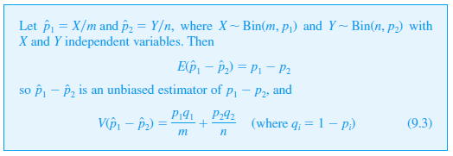
Inferences Concerning a Difference Between Population Proportions
Proposition

Slide 7


Inferences Concerning a Difference Between Population Proportions
Proof
We will focus first on situations in which both m and n are large.

Slide 8


Inferences Concerning a Difference Between Population Proportions
Then because ${\hat{p}}_{1}$and ${\hat{p}}_{2}$ individually have approximately normal distributions, the estimator ${\hat{p}}_{1}−{\hat{p}}_{2}$also has approximately a normal distribution. Standardizing ${\hat{p}}_{1}−{\hat{p}}_{2}$ yields a variable Z whose distribution is approximately standard normal:

Slide 9
A Large-Sample Test Procedure

Slide 10

A Large-Sample Test Procedure
The most general null hypothesis an investigator might consider would be of the form H₀: p₁ – p₂ = Although for population means the case ≠ 0 presented no difficulties, for population proportions = 0 and ≠ 0 must be considered separately. Since the vast majority of actual problems of this sort involve = 0 (i.e., the null hypothesis p₁ = p₂). we’ll concentrate on this case. When H₀: p₁ – p₂ = 0 is true, let p denote the common value of p₁ and p₂ (and similarly for q).

Slide 11
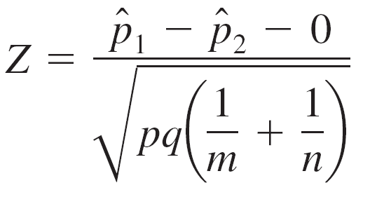
A Large-Sample Test Procedure
Then the standardized variable (9.4) has approximately a standard normal distribution when H₀ is true. However, this Z cannot serve as a test statistic because the value of p is unknown—H₀ asserts only that there is a common value of p, but does not say what that value is.

Slide 12
A Large-Sample Test Procedure
A test statistic results from replacing p and q in (9.4) by appropriate estimators. Assuming that p₁ = p₂ = p, instead of separate samples of size m and n from two different populations (two different binomial distributions), we really have a single sample of size m + n from one population with proportion p. The total number of individuals in this combined sample having the characteristic of interest is X + Y. The natural estimator of p is then
(9.5)

Slide 13



A Large-Sample Test Procedure
The second expression for shows that it is actually a weighted average of estimators and obtained from the two samples. Using and = 1 – in place of p and q in (9.4) gives a test statistic having approximately a standard normal distribution when H₀ is true.

Slide 14
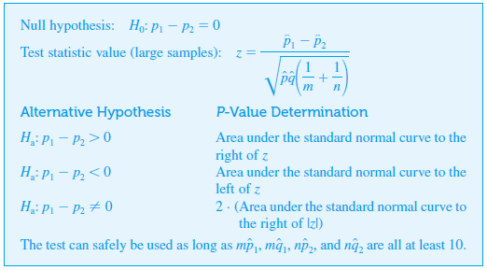
A Large-Sample Test Procedure

Slide 15
Example 9.11
The article “Aspirin Use and Survival After Diagnosis of Colorectal Cancer” (J. of the Amer. Med. Assoc., 2009: 649–658) reported that of 549 study participants who regularly used aspirin after being diagnosed with colorectal cancer, there were 81 colorectal cancer-specific deaths, whereas among 730 similarly diagnosed individuals who did not subsequently use aspirin, there were 141 colorectal cancer-specific deaths.
Does this data suggest that the regular use of aspirin after diagnosis will decrease the incidence rate of colorectal cancer-specific deaths? Let’s test the appropriate hypotheses using a significance level of .05.

Slide 16
Example 9.11
cont’d
The parameter of interest is the difference p₁ – p₂, where p₁ is the true proportion of deaths for those who regularly used aspirin and p₂ is the true proportion of deaths for those who did not use aspirin.
The use of aspirin is beneficial if p₁ < p₂ which corresponds to a negative difference between the two proportions.
The relevant hypotheses are therefore H₀: p₁ – p₂ = 0 versus H_{a}: p₁ – p₂ < 0

Slide 17
Example 9.11
cont’d
Parameter estimates are = 81/549 = .1475,
= 141/730 = .1932 and =(81 + 141)/(549 + 730) = .1736.
A z test is appropriate here because all of and are at least 10. The resulting test statistic value is
The corresponding P-value for a lower-tailed z test is (– 2.14) = .0162.

Slide 18
Example
cont’d
Because .0162 ≤ .05, the null hypothesis can be rejected at significance level .05.
So anyone adopting this significance level would be convinced that the use of aspirin in these circumstances is beneficial.
However, someone looking for more compelling evidence might select a significance level .01 and then not be persuaded.

Slide 19
Type II Error Probabilities and Sample Sizes

Slide 20
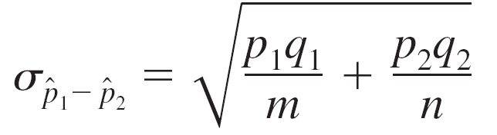
Type II Error Probabilities and Sample Sizes
Here the determination of β is a bit more cumbersome than it was for other large sample tests. The reason is that the denominator of Z is an estimate of the standard deviation of assuming that p₁ = p₂ = p. When H₀ is false, must be restandardized using (9.6) The form of σ implies that β is not a function of just p₁ – p₂, so we denote it by β(p₁, p₂).

Slide 21
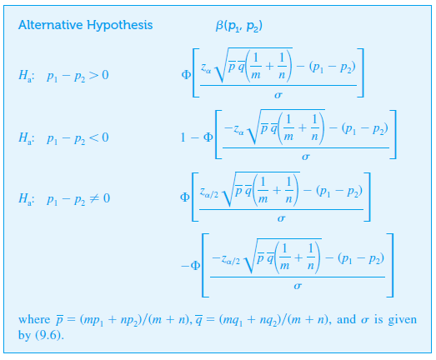
Type II Error Probabilities and Sample Sizes

Slide 22
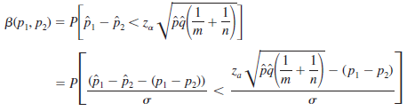
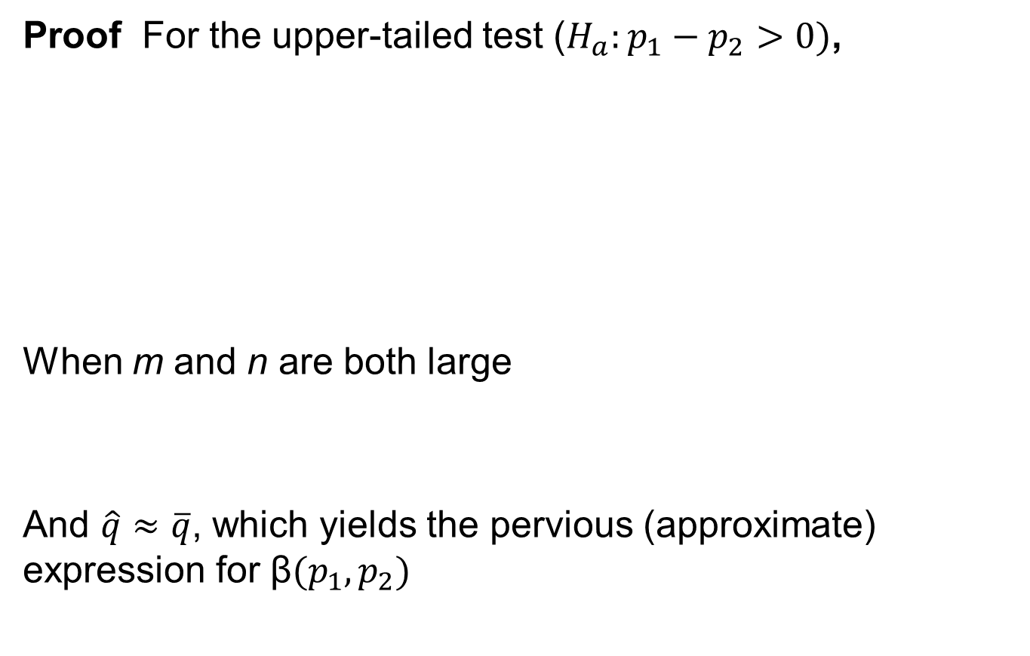
Type II Error Probabilities and Sample Sizes
Proof For the upper-tailed test ($H_{a}:p_{1}−p_{2}>0)$,
When m and n are both large
And $\hat{q}≈\overline{q}$, which yields the pervious (approximate) expression for β$(p_{1},p_{2})$

Slide 23
Type II Error Probabilities and Sample Sizes
Alternatively, for specified p₁, p₂ with p₁ – p₂ = d, the sample sizes necessary to achieve β(p₁, p₂) = β can be determined. For example, for the upper-tailed test, we equate –z_{β} to the argument of (i.e., what’s inside the parentheses) in the foregoing box. If m = n, there is a simple expression for the common value.

Slide 24
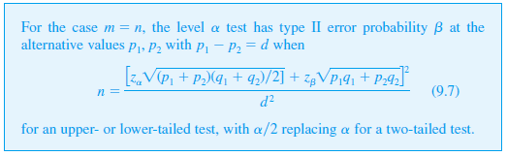
Type II Error Probabilities and Sample Sizes

Slide 25
Example
One of the truly impressive applications of statistics occurred in connection with the design of the 1954 Salk polio-vaccine experiment and analysis of the resulting data.
Part of the experiment focused on the efficacy of the vaccine in combating paralytic polio.
Because it was thought that without a control group of children, there would be no sound basis for assessment of the vaccine, it was decided to administer the vaccine to one group and a placebo injection (visually indistinguishable from the vaccine but known to have no effect) to a control group.

Slide 26
Example
cont’d
For ethical reasons and also because it was thought that the knowledge of vaccine administration might have an effect on treatment and diagnosis, the experiment was conducted in a double-blind manner.
That is, neither the individuals receiving injections nor those administering them actually knew who was receiving vaccine and who was receiving the placebo (samples were numerically coded).
(Remember: at that point it was not at all clear whether the vaccine was beneficial.)

Slide 27
Example
cont’d
Let p₁ and p₂ be the probabilities of a child getting paralytic polio for the control and treatment conditions, respectively.
The objective was to test H₀: p₁ – p₂ = 0 versus H_{a}: p₁ – p₂ > 0 (the alternative states that a vaccinated child is less likely to contract polio than an unvaccinated child).
Supposing the true value of p₁ is .0003 (an incidence rate of 30 per 100,000), the vaccine would be a significant improvement if the incidence rate was halved—that is, p₂ = .00015.

Slide 28
Example
cont’d
Using a level α = .05 test, it would then be reasonable to ask for sample sizes for which β = .1 when p₁ = .0003 and p₂ = .00015.
Assuming equal sample sizes, the required n is obtained from (9.7) as
= [(.0349 + .0271)/.00015]² ≈ 171,000

Slide 29
Example
cont’d
The actual data for this experiment follows. Sample sizes of approximately 200,000 were used.
The reader can easily verify that z = 6.43—a highly significant value. The vaccine was judged a resounding success!
Placebo: m = 201,229,
x = number of cases of paralytic polio = 110
Vaccine: n = 200,745,
y = 33

Slide 30
A Large-Sample Confidence Interval

Slide 31

A Large-Sample Confidence Interval
As with means, many two-sample problems involve the objective of comparison through hypothesis testing, but sometimes an interval estimate for p₁ – p₂ is appropriate. Both and have approximate normal distributions when m and n are both large. If we identify θ with p₁ – p_{2,}, then satisfies the conditions necessary for obtaining a large-sample CI. In particular, the estimated standard deviation of is

Slide 32
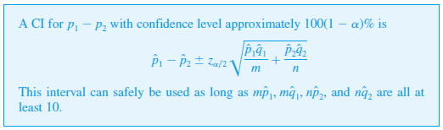
A Large-Sample Confidence Interval
The general 100(1 – α )% interval then takes the following form.

Slide 33

A Large-Sample Confidence Interval
Notice that the estimated standard deviation of (the square-root expression) is different here from what it was for hypothesis testing when = 0. Recent research has shown that the actual confidence level for the traditional CI just given can sometimes deviate substantially from the nominal level (the level you think you are getting when you use a particular z critical value—e.g., 95% when z_{α/2} = 1.96).

Slide 34


A Large-Sample Confidence Interval
The suggested improvement is to add one success and one failure to each of the two samples and then replace the and in the foregoing formula by and where = (x + 1)/(m + 2), etc. This modified interval can also be used when sample sizes are quite small.

Slide 35
Example
Do people who work long hours have more trouble sleeping? An investigation into this issue was described in the article “Long Working Hours and Sleep Disturbances: The Whitehall II Prospective Cohort study” (Sleep, 2009: 737– 745).
In one sample of 1501 British civil servants who worked more than 40 hours a week, 750 said they usually get less than 7 hours of sleep per night. In another sample of 958 British civil servants who worked between 35 and 40 hours per week, 407 said they usually get less than 7 hours of sleep per night.

Slide 36

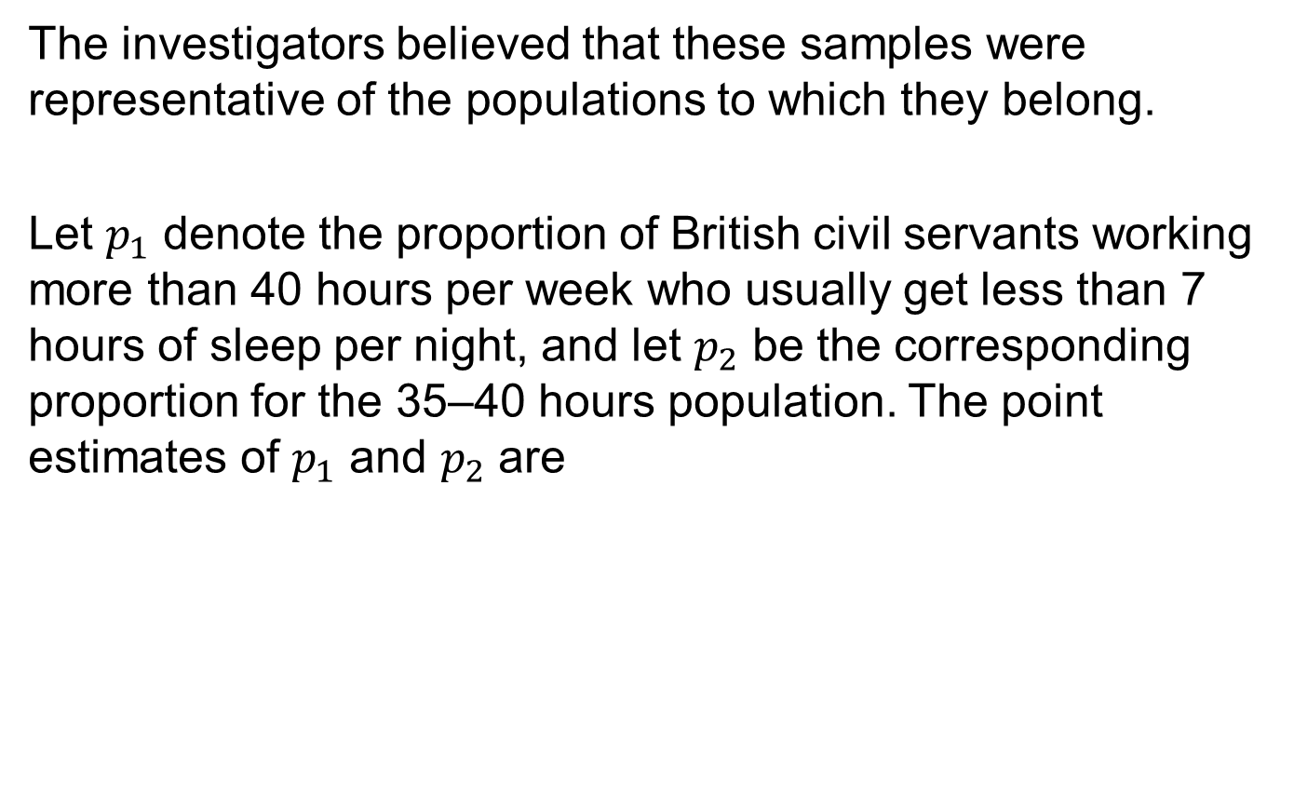
Example
cont’d
The investigators believed that these samples were representative of the populations to which they belong.
Let $p_{1}$ denote the proportion of British civil servants working more than 40 hours per week who usually get less than 7 hours of sleep per night, and let $p_{2}$ be the corresponding proportion for the 35–40 hours population. The point estimates of $p_{1}$ and $p_{2}$ are

Slide 37

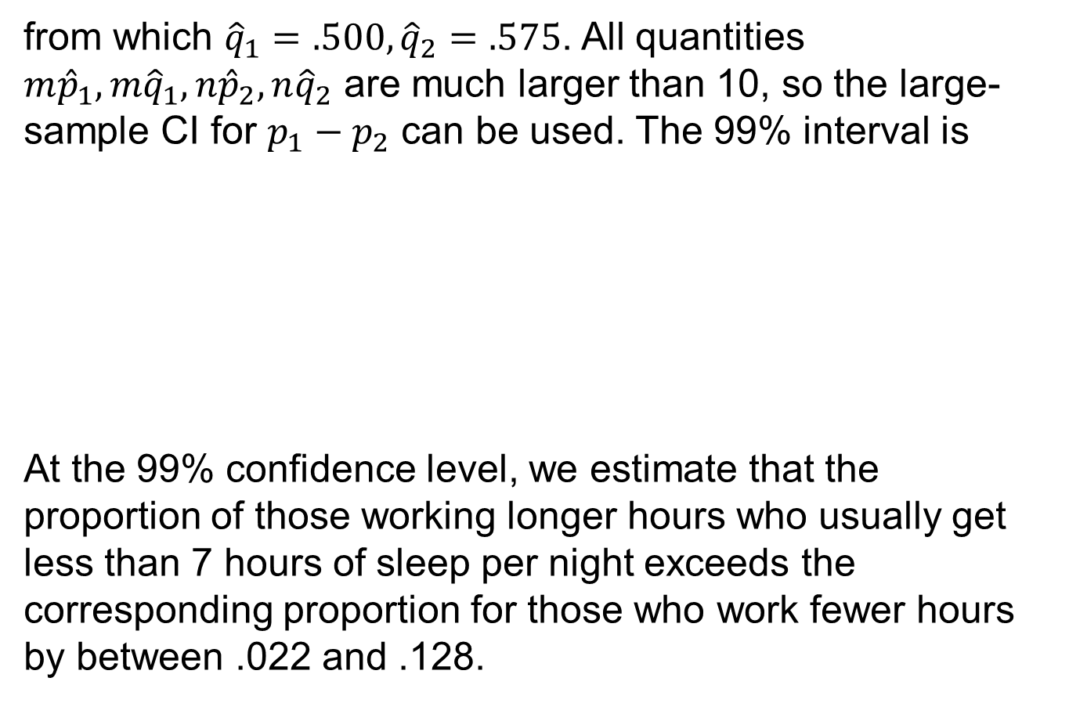
Example
cont’d
from which ${\hat{q}}_{1}=.500, {\hat{q}}_{2}=.575$. All quantities ${m\hat{p}}_{1},{m\hat{q}}_{1},{n\hat{p}}_{2},{n\hat{q}}_{2}$ are much larger than 10, so the large-sample CI for $p_{1}−p_{2}$ can be used. The 99% interval is
At the 99% confidence level, we estimate that the proportion of those working longer hours who usually get less than 7 hours of sleep per night exceeds the corresponding proportion for those who work fewer hours by between .022 and .128.

Slide 38
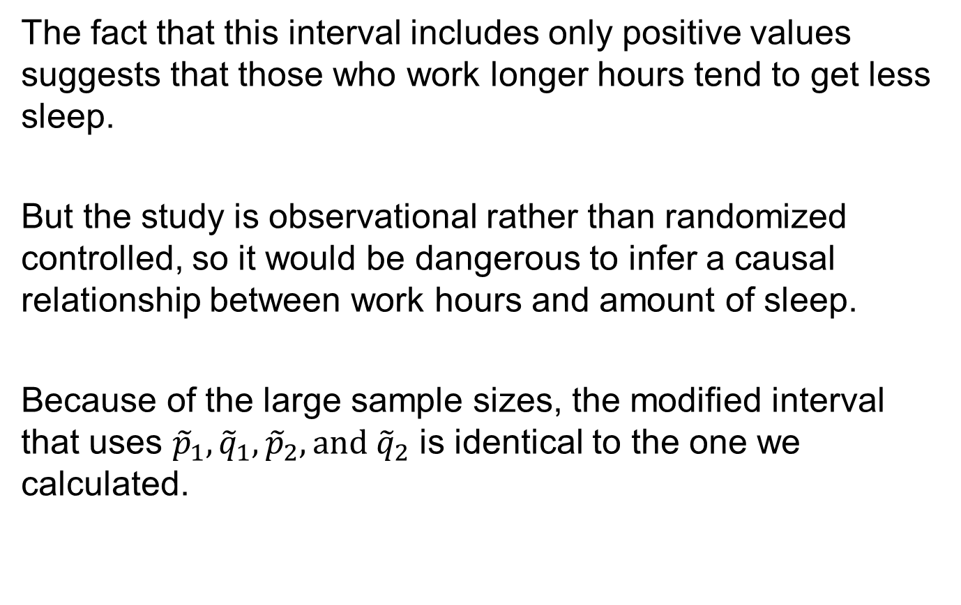
Example
cont’d
The fact that this interval includes only positive values suggests that those who work longer hours tend to get less sleep.
But the study is observational rather than randomized controlled, so it would be dangerous to infer a causal relationship between work hours and amount of sleep.
Because of the large sample sizes, the modified interval that uses ${\tilde{p}}_{1},{\tilde{q}}_{1},{\tilde{p}}_{2},{and \tilde{q}}_{2}$ is identical to the one we calculated.

Slide 39
Small-Sample Inferences

Slide 40
Small-Sample Inferences
On occasion an inference concerning p₁ – p₂ may have to be based on samples for which at least one sample size is small. Appropriate methods for such situations are not as straightforward as those for large samples, and there is more controversy among statisticians as to recommended procedures. One frequently used test, called the Fisher–Irwin test, is based on the hypergeometric distribution. Your friendly neighborhood statistician can be consulted for more information.

